Slide 1

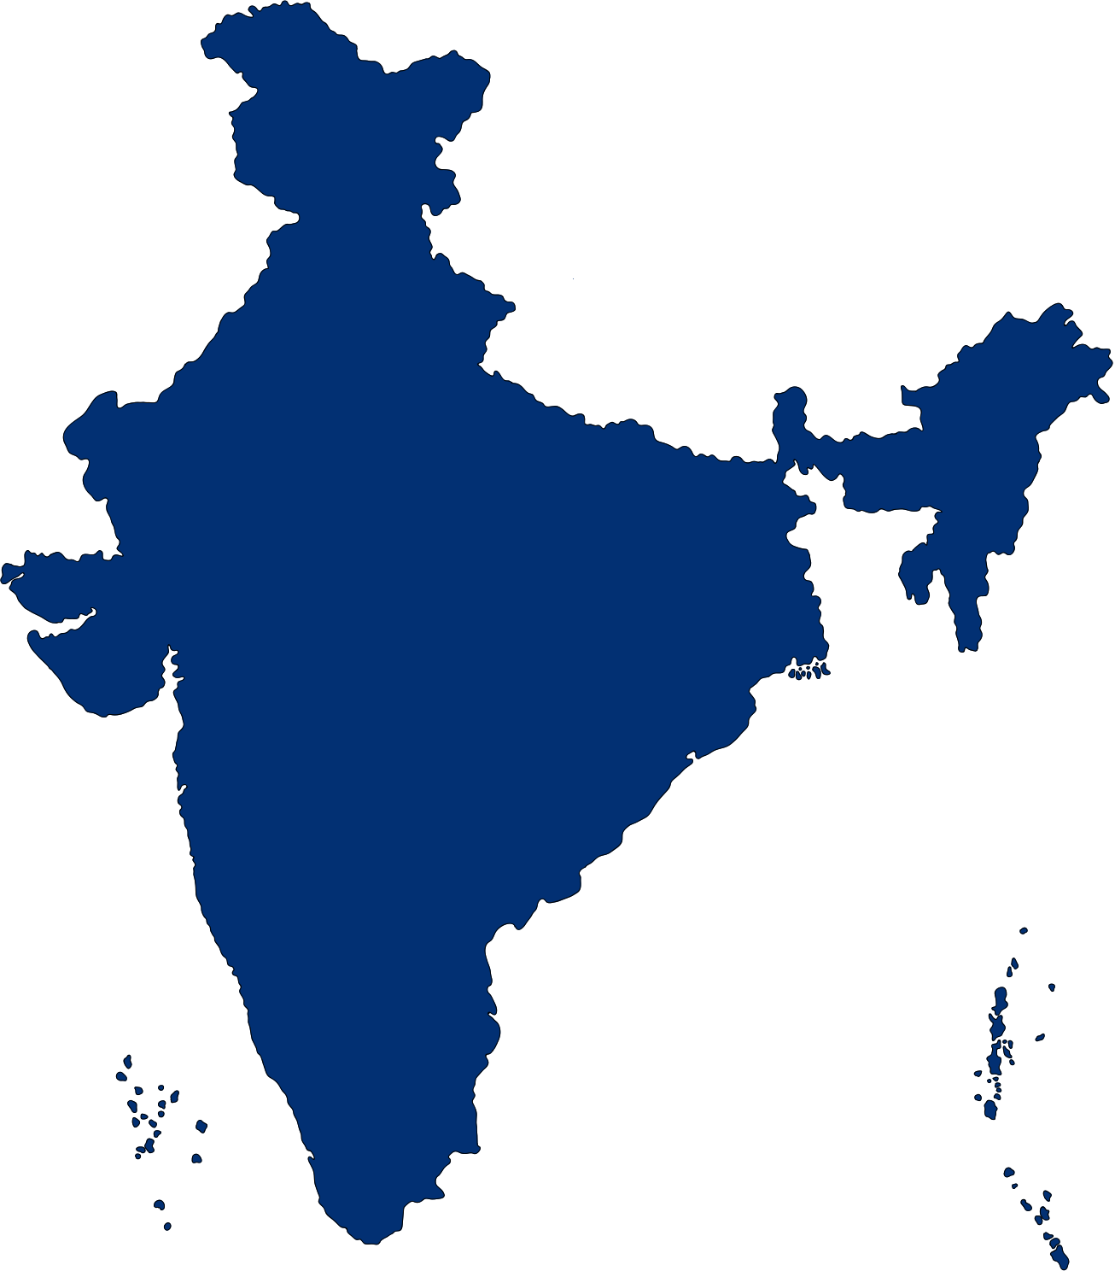

ReguFlow
Next-Generation AI-Driven Regulatory Compliance Orchestration for Enterprise Banking
Team Swaraj
Lakshdeep Singh - Backend & Workflow Systems Lead
2. Nikhil Advani - AI & Regulatory Intelligence Lead
3. Lavanya Gehlot- Frontend Lead
4. Ayush Choudhary - Research and Analysis Lead
Su₹क्षा Hackathon 2026

Slide 2

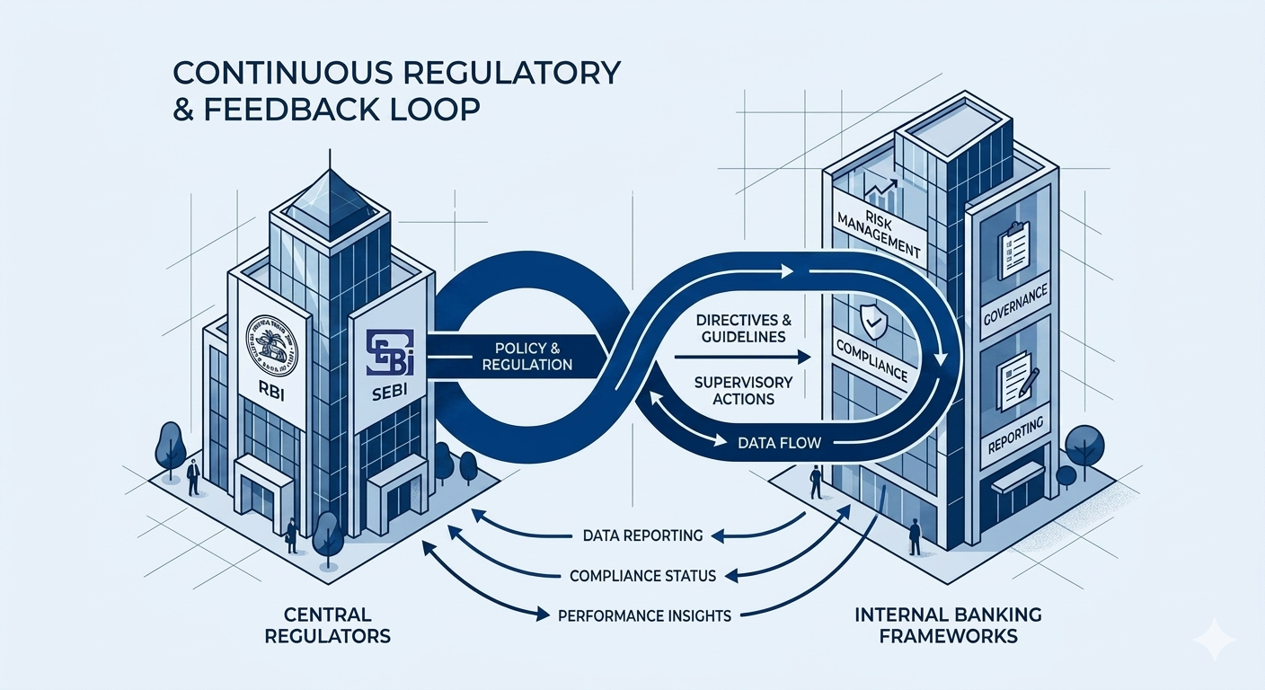
Problem Statement
The Compliance Bottleneck & The Velocity Gap
Prose to Production Friction: Central bank circulars are lengthy, nested, multi-page PDFs containing deeply technical requirements mixed with general advisories.
The Audit Trail Void: Tracking the manual path of a directive—from initial legal interpretation to explicit IT change validation—is highly fragmented, slow, and heavily prone to human error.
The Regulatory Cost: Failure or delays in translating updates lead to immediate operational vulnerabilities and severe financial compliance penalties.
02

Slide 3

Our Solution
An AI-powered deterministic compliance orchestration platform that transforms RBI circulars into executable and auditable workflows
Parsing Over Autonomy: ReguFlow treats Large Language Models strictly as contextual parsers and translators, not autonomous decision-makers.
The MAP Paradigm: Automated deconstruction of raw legal text into machine-readable, traceable Measurable Action Points (MAPs).
Zero-Trust Engineering Strategy: Built specifically to support on-premises, air-gapped container execution (Docker), completely satisfying national data privacy acts (like India's DPDP Act) with zero public API leaks.
03

Slide 4
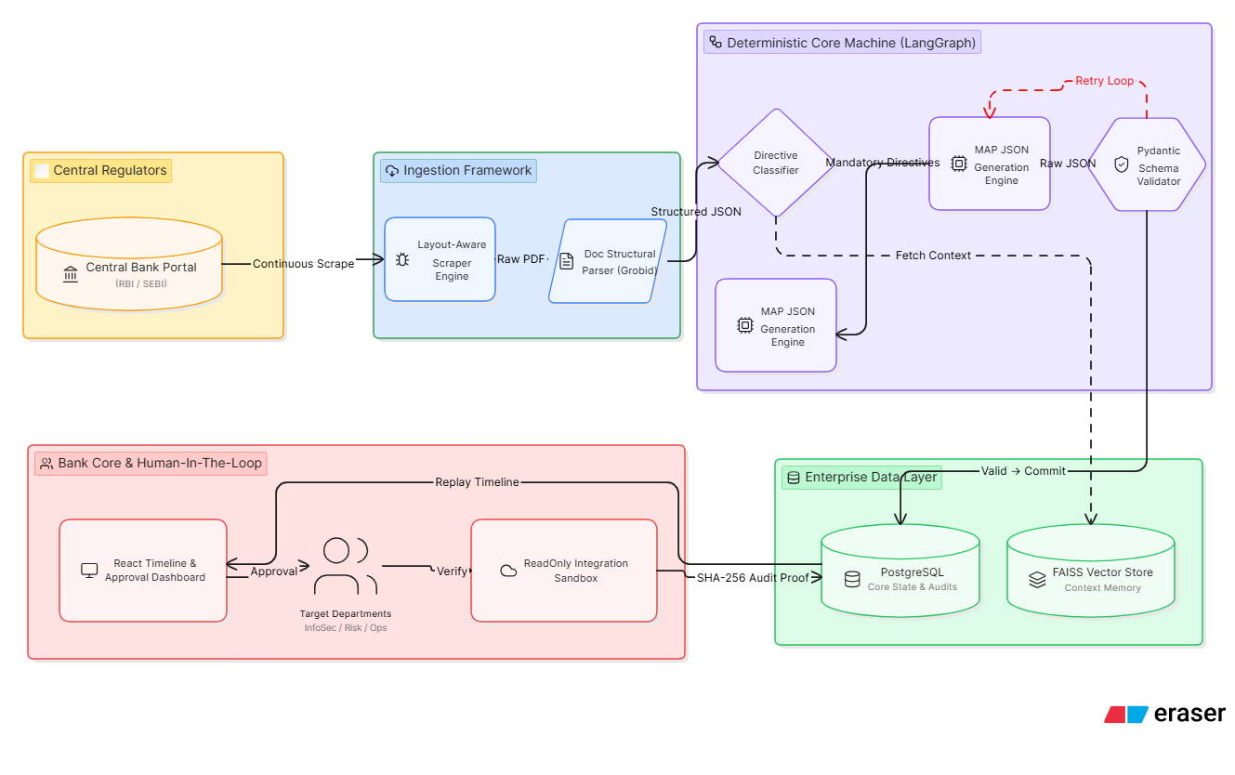
Core Engine Architecture
Layout-Aware Ingestion: Advanced parsing layer preserves nested tables, cross-referenced historical documents, and appendix criteria.
LangGraph Orchestration Machine: Enforces strict, rule-based state transitions that constrain the parsing swarms into predictable execution bounds.
Pydantic Type Enforcement: Serializes unstructured legal directives into rigorous, typed JSON schemas a specific operational roles (e.g., InfoSec, Risk Management, Database Operations).
04

Slide 5

Secure Verification Logs & Immutable Audit Trails
The Core Policy Boundary: The platform acts as a recommendation layer; zero operational updates are promoted to production without multi-tiered human sign-off via a Role-Based Access Control (RBAC) panel.
ReadOnly Automated Auditing: The verification engine runs read-only integration tests against isolated test environments to verify compliance states (e.g., querying database configurations to confirm active encryption).
Cryptographic Record Keeping: Computes an immutable SHA-256 hash at every operational lifecycle phase, guaranteeing tamper-proof logs for regulatory examiners.
Complete Regulatory Accountability Chain Maintains a transparent timeline of who reviewed, approved, validated, and executed each compliance directive
04

Slide 6
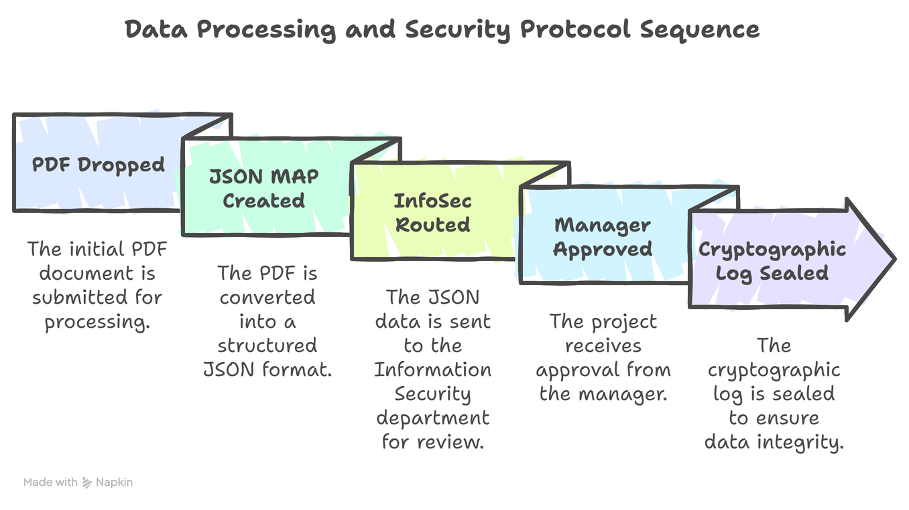
Production-Ready Enterprise Stack
Backend: FastAPI (optimized for highly parallel asynchronous network calls).
Storage & Vector Layer: PostgreSQL + FAISS / ChromaDB.
AI State Management: LangChain & LangGraph.
Security & Operations: JWT Authentication + RBAC + Isolated Docker Environments.
06

Slide 7

Business Impact & Future Vision
Home
Photo
About Us
ReguFlow not as a simple technical tool, but as a mandatory, next-generation AI operating system built to preserve institutional trust and compliance safety across the entire banking ecosystem.
Quantifiable Efficiency: Lowers the operational transition window of new regulations from weeks to mere minutes.
Total Risk Mitigation: Eliminates human translation slip-ups, dramatically lowering compliance vulnerabilities and audit failures.
Future Scope: Cross-organizational scaling to support localized, regional bank guidelines and automated internal audit generation.
08

Slide 8

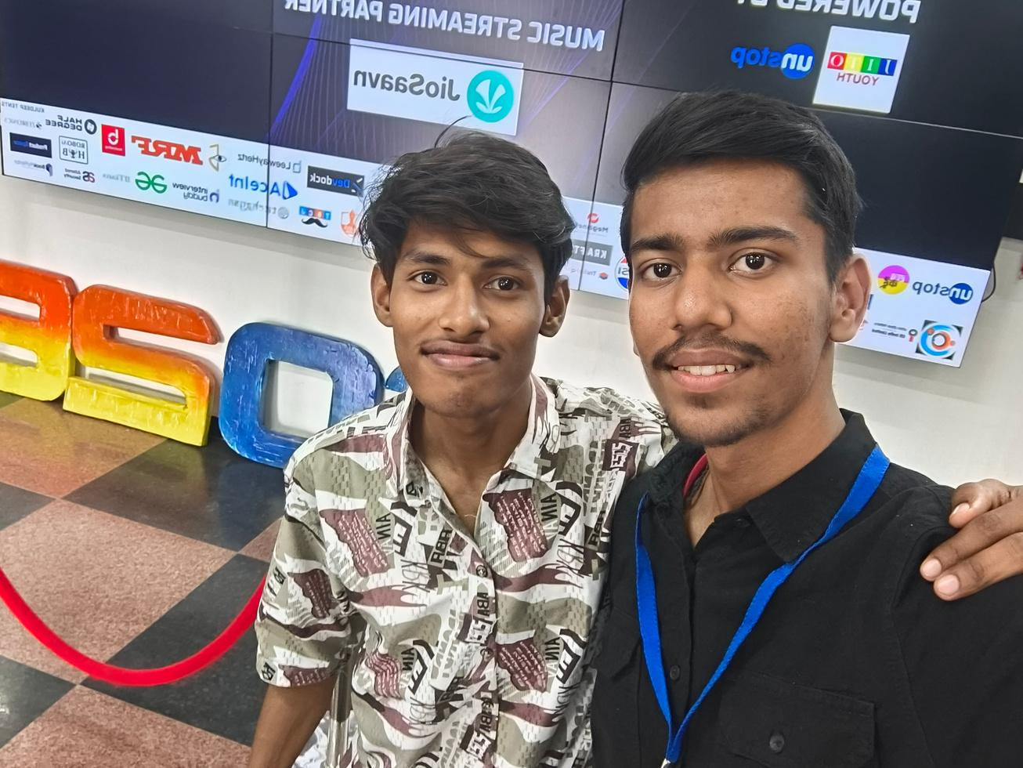

Meet Our Team
Meet the passionate minds behind our vision — a team driven by innovation, collaboration, and results.
Lakshdeep Singh
Nikhil Advani
Lavanya
Gehlot
08

Slide 9
Thank You
Thank you for your time and consideration. We’re excited to innovate and contribute through the Suraksha Hackathon
09

